Slide 1
Quotes to Ponder Copy as many quotes as you can from around the classroom. Add to your quotes as you travel from class to class and see new ones you like. Feel free to add your own quotes and words of wisdom from the people you love.

Slide 2
"He who has imagination without learning has wings but no feet."
~Joseph Joubert
Imagination/creativity + learning = success
Without an education, your imagination and dreams won’t take you anywhere. Both are important.
2

Slide 3
"Joy is not in things! It is in us!"
Benjamin Franklin
3

Slide 4
“Insanity: doing the same thing over and over again and expecting different results.”
~Albert Einstein
4

Slide 5
“Life has no limitations, except the ones you make.”
~ Les Brown
5

Slide 6
“Your life will be no better than the plans you make and the action you take. You are the architect and builder of your own life, fortune, destiny.”
~Alfred A. Montapert
6

Slide 7
"I like nonsense, it wakes up the brain cells. Fantasy is a necessary ingredient in living, it's a way of looking at life through the wrong end of a telescope."
~Dr. Seuss
7

Slide 8
“Home is the nicest word there is."
~Laura Ingalls Wilder
8

Slide 9
“He who closes his ears to the views of others shows little confidence in the integrity of his own views.”
William Congreve
9

Slide 10
“You can choose to be completely pulled down; you can let bullying change you or you can let it make you aggressive and mean just like they are, or you can channel your pain. (into something positive)
That can do nothing but pull you up and motivate you.”
Taylor Swift
10

Slide 11
“Arrogance frowns; pride smiles.”
~ Mason Cooley
It’s good to have pride in yourself for your accomplishments, your school, etc., but don’t act better than others.
11

Slide 12
"A person who won't read has no advantage over one who can't read."
~Mark Twain
12

Slide 13
"Our lives begin to end the day we become silent about things that matter."
~Martin Luther King, Jr.
13

Slide 14
"What lies behind us and what lies before us are tiny matters compared to what lies within us."
~Ralph Waldo Emerson
14

Slide 15
Hard work beats talent, when talent doesn't work hard.
~ Unknown
15

Slide 16
“Sometimes good things fall apart so better things can fall together.”
16

Slide 17
“No matter how many mistakes you make or how slow you progress, you are still way ahead of everyone who isn’t trying.”
(Read Unstoppable .)
17

Slide 18
"Keep away from people who try to belittle your ambitions. Small people always do that, but the really great make you feel that you, too, can become great."
~Mark Twain
18

Slide 19
Beauty is not in the face; beauty is a light in the heart.
~Kahlil Gibran
19

Slide 20
Whatever we plant in our subconscious mind and nourish with repetition and emotion will one day become a reality.
~Earl Nightingale
20

Slide 21
"Don't ever take a fence down until you know why it was put up."
~Robert Frost
21

Slide 22
A good book should leave you... slightly exhausted at the end. You live several lives while reading it.
~William Styron
22

Slide 23
"Educating the mind without educating the heart is no education at all."
~Aristotle
23

Slide 24
A good listener is a silent flatterer
~Proverb
24

Slide 25
“Truth is like the sun. You can shut it out for a time, but it ain't goin' away.”
~Elvis Presley
25

Slide 26
Your time is limited, so don't waste it living someone else's life. Don't be trapped by dogma - which is living with the results of other people's thinking. Don't let the noise of other's opinions drown out your own inner voice. And most important, have the courage to follow your heart and intuition. They somehow already know what you truly want to become. Everything else is secondary.
Steve Jobs
26

Slide 27
It is wise to direct your anger towards problems - not people; to focus your energies on answers - not excuses.
William Ward
27

Slide 28
"The aim of education should be to teach us rather how to think, than what to think."
~Bill Beattie
28

Slide 29
Those who are lifting the world upward and onward are those who encourage more than criticize.
~Elizabeth Harrison
29

Slide 30
"Use what talents you possess; the woods would be very silent if no birds sang except those who sang best."
~Henry Van Dyke
30

Slide 31
“Being powerful is like being a lady. If you have to tell people you are, you aren't.”
~Margaret Thatcher
31

Slide 32
“You hit a wall, you push through it.”
“Freedom is not free.”
Unknown
32

Slide 33
"I never could have done what I have done without the habits of punctuality, order, and diligence, without the determination to concentrate myself on one subject at a time.“
~Charles Dickens

Slide 34
"Happiness is when what you think, what you say, and what you do are in harmony."
~Mahatma Gandhi

Slide 35
"I find television very educating. Every time somebody turns on the set, I go into the other room and read a book."
~Groucho Marx

Slide 36
36

Slide 37
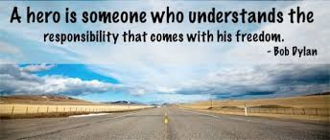

Slide 38
38

Slide 40
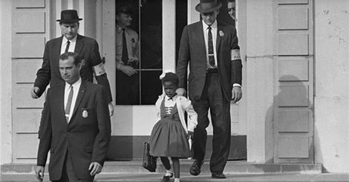
Courage: Ruby Bridges November 14, 1960 (born September 8, 1954) is an American activist known for being the first black child to attend an all-white elementary school in the South. She attended William Franz Elementary School.

Slide 41
41

Slide 42
42

Slide 43
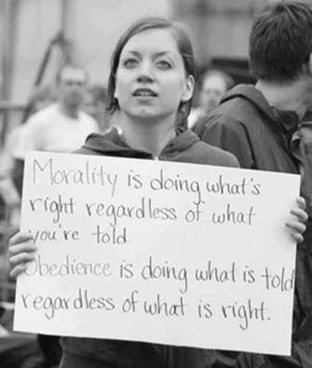
43

Slide 44
44

Slide 45
45

Slide 46
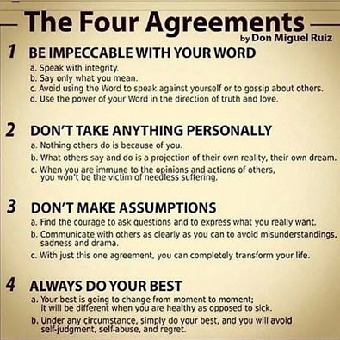
46

Slide 47
First, have a definite, clear practical idea; a goal, an objective. Second, have the necessary means to achieve your ends; wisdom, money, materials, and methods. Third, adjust all your means to that end.
~ Aristotle

Slide 48
“Every new beginning comes from some other beginning's end.”
~Seneca

Slide 49
When a person you love passes away
Look to the night sky on a clear day.
The star that to you, appears to be bright,
Will be your loved one,
Looking upon you during the night.
The lights of heaven are what shows through.
As your loved one watches all that you do.
When you feel lonely for the one that you love,
Look to the Heavens in the night sky above.
-Author Unknown

