Slide 1


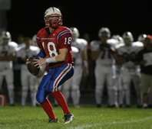
PAWNEE INDIANS

Slide 2


No B.O.
Always wear deodorant! Always!

Slide 3
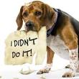

Homework Responsibility
Listen to instructions about homework, and always complete it
Ask a friend or sibling to get your homework if you are sick
Write down assignments in your assignment notebook

Slide 4

Homework
Use study hall to do homework; you don’t have to bring as much home then
Even if your homework is not all finished, turn it in. It is worth some points

Slide 5

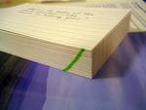

When offered extra credit, do it!
Make flash cards to help you study.

Slide 6

Always study for test. Start a day or two ahead of time for the big test
Make sure to study the vocab. It’s always on the test
Listen and ask questions in class

Slide 7


Keeping your grades up
You need to keep your grades up if you play sports
You need to focus on your grades, not your social life

Slide 8
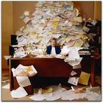

Be Organized
Don’t stuff your papers in books. Use folders.

Slide 9
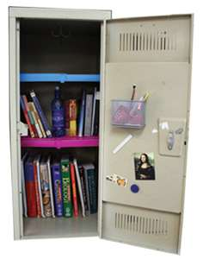
LOCKER TIPS
Keep your locker cleaned and
organized
Always lock your locker, and don’t tell anyone your combination
Don’t carry your phone with you. It’s supposed to be in your locker
Make sure you take all food out of locker! You can get mold or mice

Slide 10
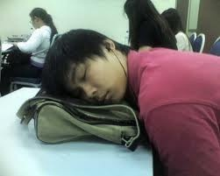
Don’t Procrastinate
Don’t wait till the last quarter to start trying your best to pass.

Slide 11


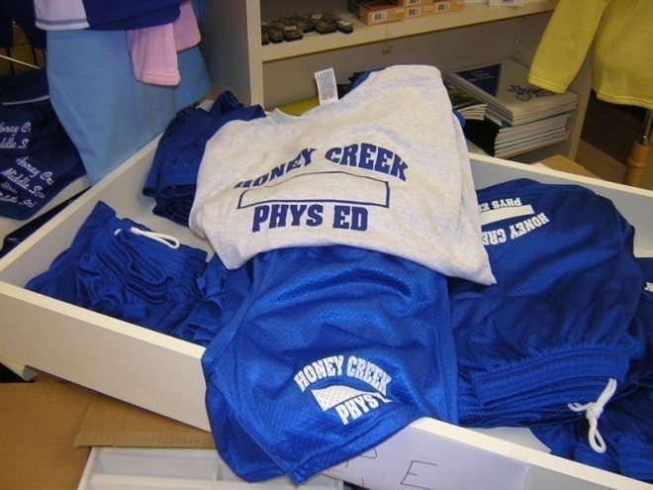
Math, Chorus, and P.E.
Always keep track of your math notes, he takes a grade on them
Sing loud and clear in chorus
Bring your P.E. clothes home often to wash them

Slide 12

Be Respectful
Be respectful to all your teachers and your fellow students.

Slide 13

Teachers
Try not to talk while the teacher is talking.

Slide 14
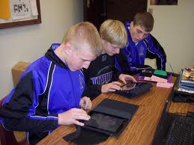
Partner Time
If you get to work with a partner in class, use that time to work, not to chit-chat. You may not be able to work on it outside of class

Slide 15

A.R Books
Read your A.R books. You will get to go to Krekel’s if you make your goal.
If you wait till the last week, you'll have to read during lunch in Mrs. Copp’s Room.
Always bring your A.R Book to class!

Slide 16

Responsibility
Be prepared for any unexpected event, Like a snow day.
Home Work is still due when you have class again!

Slide 17


JR. High survival tips
Use the bathrooms at lunch
Eat breakfast in the mornings
Don’t stay up all night on school nights; teachers can tell the next day
Try to memorize your schedule. It’s time wasting if you spend the whole passing period trying to remember where to go next

Slide 18


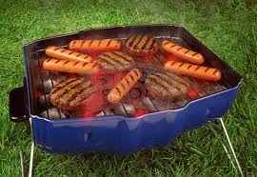
FOOD
Teachers are always looking for a way to ban ala cart, so be good
You need to have money in your lunch account
Junior high has a cookout at the end of the year

Slide 19

Tips about teachers
Bring a sweatshirt / hoodie to Mr. R. Hennemann’s room
Mr. C Hennemann teases everyone; have fun
Don’t chew on writing utensils or other stuff in math. Mr. Hamilton will throw the chewed up item away

Slide 20
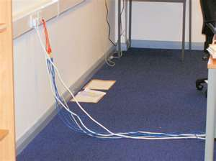

Watch your step!
Watch out for cords in classes- don’t trip.

Slide 21


Activities
Try to join a sport or a club because they are fun

Slide 22

Stay young
Go with friends to the dances. Skip the dates until high school.

Slide 23



Junior High Survival Tips
Take all of your morning books to first hour
Don’t chew gum. You’ll get a detention and have to scrape gum off of desks
Try not to get pulled into the drama that some people cause

Slide 24
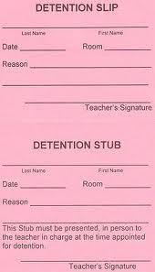


Getting into trouble
Tardies to class will lead to detentions!
Don’t cheat! Its not worth it, and you and the other person will get caught
Tell a teacher or another adult if someone is bullying you

